Slide 1
Project presentation on :- RATINGS PREDICTION PROJECT
Submitted by :
Rajashri Sadafule Darveshi

Slide 2
Table Of Contents :-
1. Introduction
1.1 Problem Statement and understanding
2. EDA steps and Visualization
3. Steps and assumptions used to complete the project
3.1 Data Pre-processing Done
3.2 Set of assumptions related to the problem under consideration
4. Model Dashboard
5. Finalized Model
6. Conclusion
7. Acknowledgement

Slide 3
INTRODUCTION
Problem statement and understanding
We have a client who has a website where people write different reviews for technical products. Now they are adding a new feature to their website i.e. The reviewer will have to add stars(rating) as well with the review. The rating is out 5 stars and it only has 5 options available 1 star, 2 stars, 3 stars, 4 stars, 5 stars. Now they want to predict ratings for the reviews which were written in the past and they don’t have rating. So we, we have to build an application which can predict the rating by seeing the review.

Slide 4
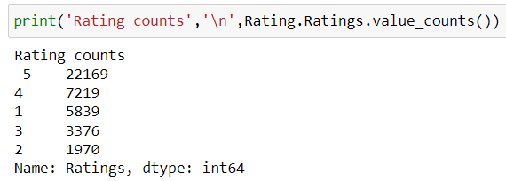
Observation
There are 40573 rows and 2 columns present in our dataset.
Maximum, 22169 number of ratings present is of 5 star and minimum, 1970 is of 2 star.

Slide 5
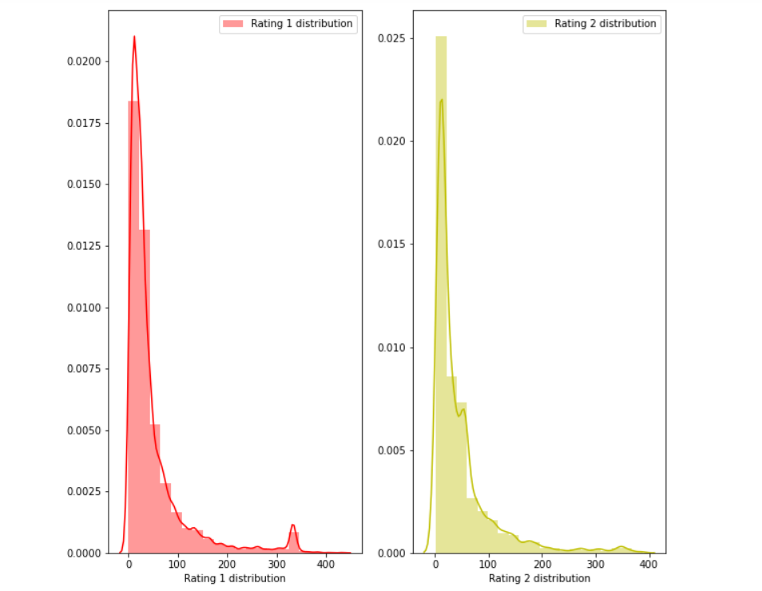
EDA steps and Visualization
Rating 1 and and Rating 2 distribution after cleaning the reviews:

Slide 6
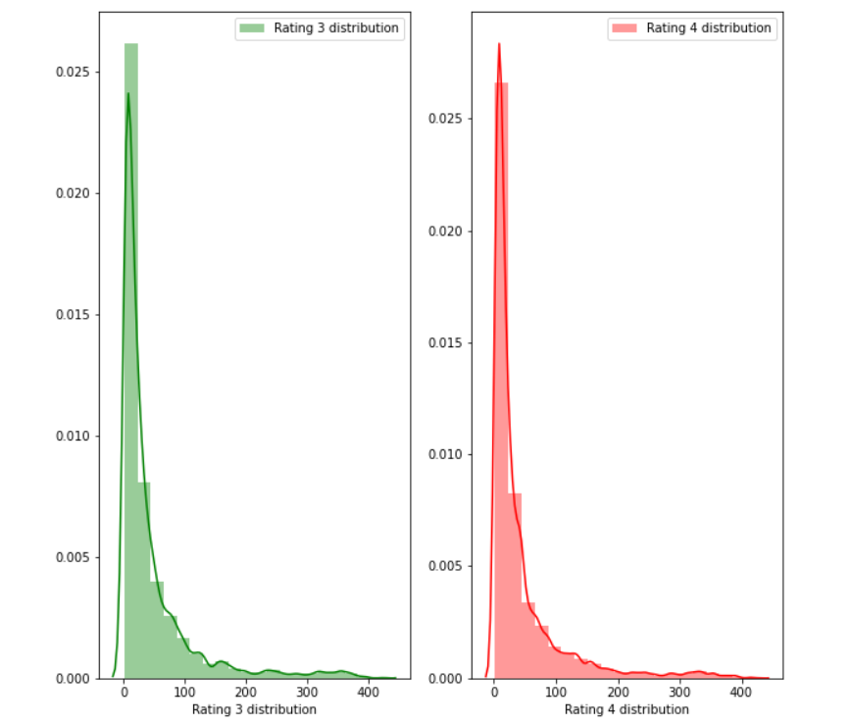
Rating 3 and and Rating 4 distribution after cleaning the reviews:

Slide 7
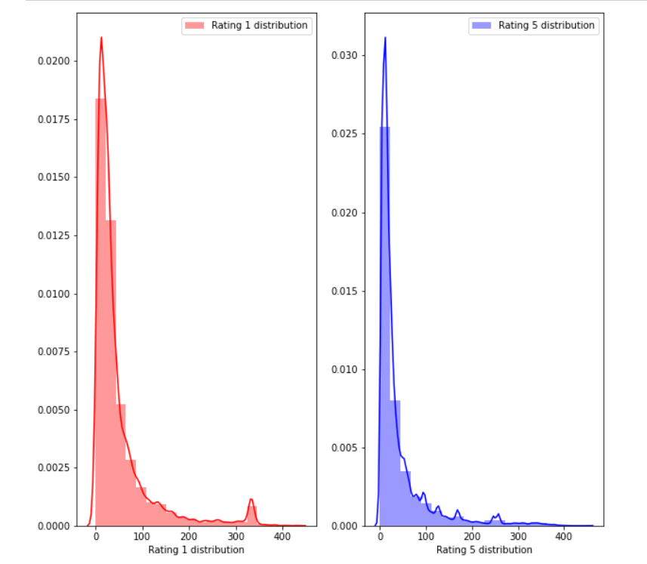
Rating 1 and Rating 5 distribution after cleaning reviews:

Slide 8
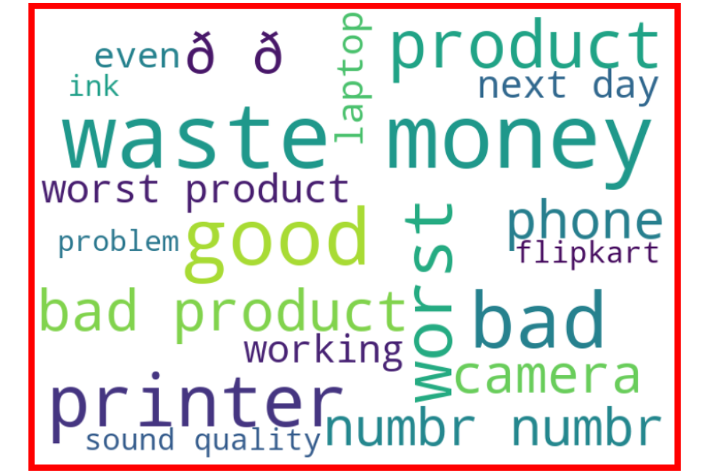
Getting sense of review Loud words in Rating 1:

Slide 9
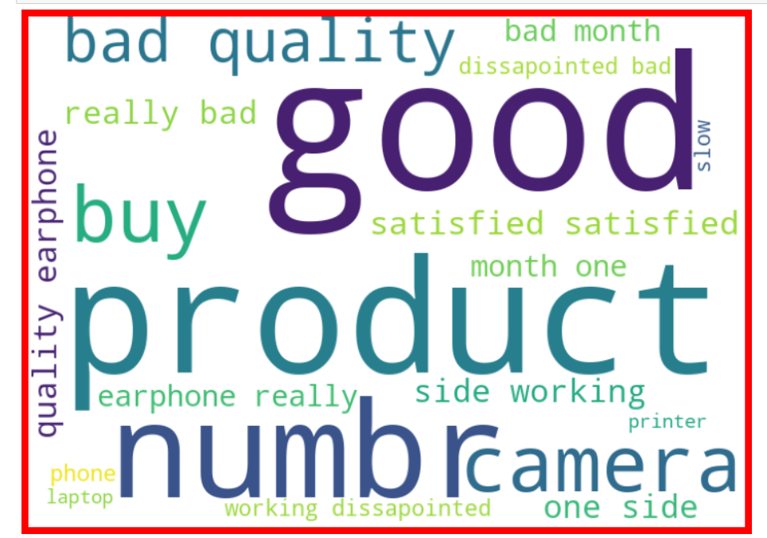
Getting sense of review Loud words in Rating 1:

Slide 10
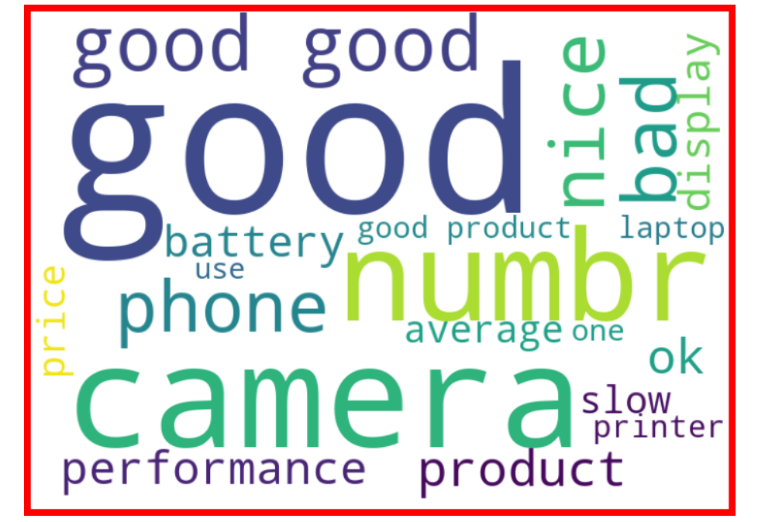
Getting sense of review Loud words in Rating 3:

Slide 11
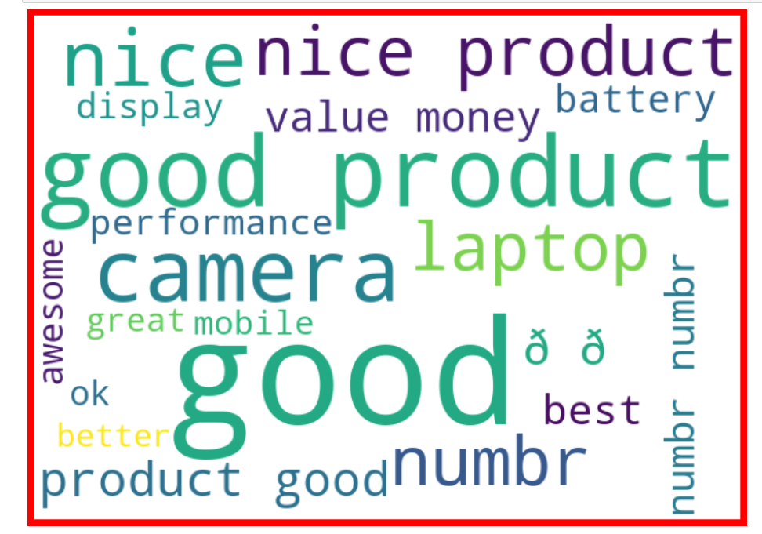
getting sense of review Loud words in Rating 4:

Slide 12
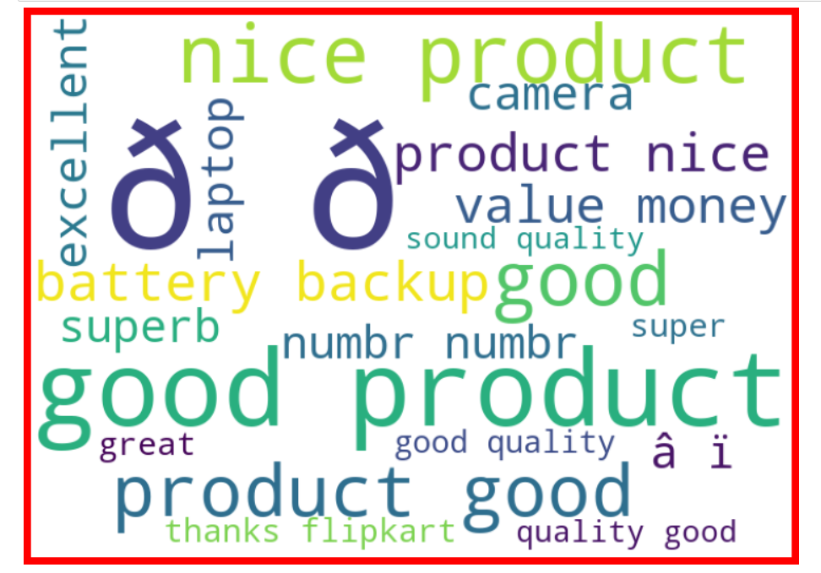
getting sense of review Loud words in Rating 5:

Slide 13

Data Preprocessing Done
We first looked for the null values present in the dataset. We noticed that there were no null values present in our dataset. Then we performed text processing. Data usually comes from a variety of sources and often in different formats. For this reason transforming your raw data is essential. However, this is not a simple process, as text data often contains redundant and repetitive words. This means that processing the text data is the first step in our solution. The fundamental steps involved in text preprocessing are, Cleaning the raw data Tokenizing the cleaned data.

Slide 14
Preprocessing involved the following steps:
Removing Punctuations and other special characters
Removing Stop Words
Stemming and Lemmatizing
Applying tfidf Vectorizer
Balancing the dataset through smote technique

Slide 15
Some very large length comments can be seen, in our dataset. These pose serious problems like adding excessively more words to the training dataset, causing training time to increase and accuracy to decrease! Hence, a threshold of 400 characters will be created and only comments which have length smaller than 400 will be used further.
Hence, after removing comments longer than 400 characters, we are still left with 115893 comments, which seems enough for training purposes.

Slide 16
Set of assumptions related to the problem under consideration
By looking into the target vaariable label we assumed that it was a Multiclass classification type of problem.
We observed that dataset was imbalance so we will have to balance the dataset for better outcome.

Slide 17
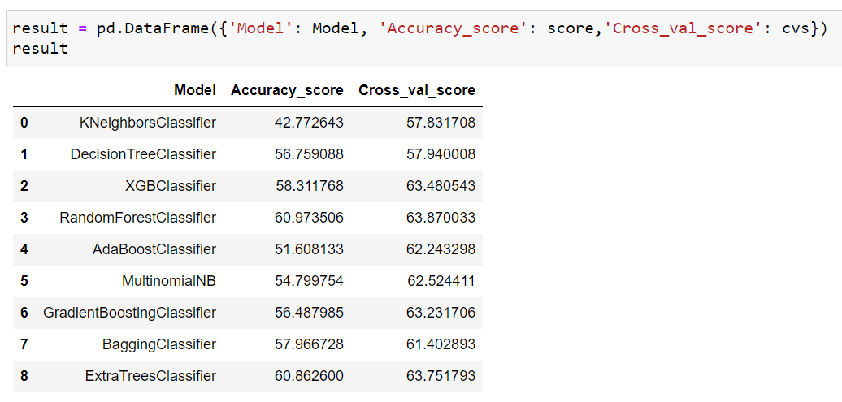
Model Dashboard​
We observe that Random forest classifier is giving is best results so we save it as our final model.

Slide 18
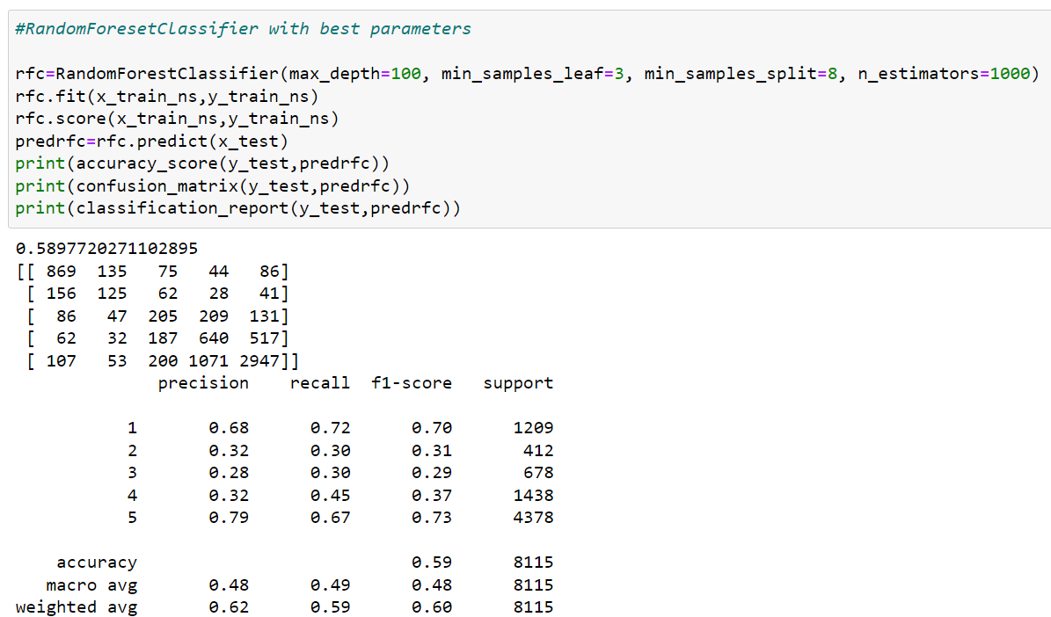
Finalized Model
We interpreted that Random forest classifier model was giving us the best results with the accuracy score of 59 and comparatively better f1-score so we saved it as our final model.

Slide 19
Conclusion
In this project we have tried to detect the Ratings in commercial websites on a scale of 1 to 5 on the basis of the reviews given by the users. We made use of natural language processing and machine learning algorithms in order to do so. We interpreted that Random forest classifier model is giving us best results.

Slide 20
Acknowledgement
I would like to express my special thanks of gratitude to the sources Medium, Towards Data Science, Stack Overflow, Data Trained, Fliprobo which helped me to accomplish this project.

Slide 21
Thank You

